Slide 1







Hii, I’m Carlos and it’s been a tough season!!!
Carlos is a small-scale grower in Brazil, having land of 30 Ha
Until he stumbled upon his inheritance from his family which was 200 Ha
He was confident he could handle this land but later which turned into a nightmare
It surely gave him a hard time and was definitely a tough season for him
Until he heard a knock at the door….

Slide 2
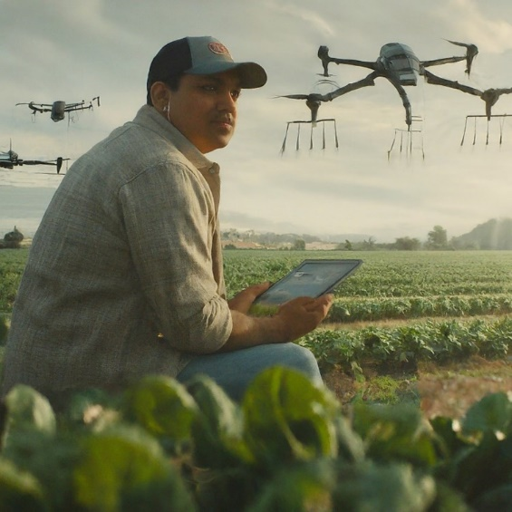
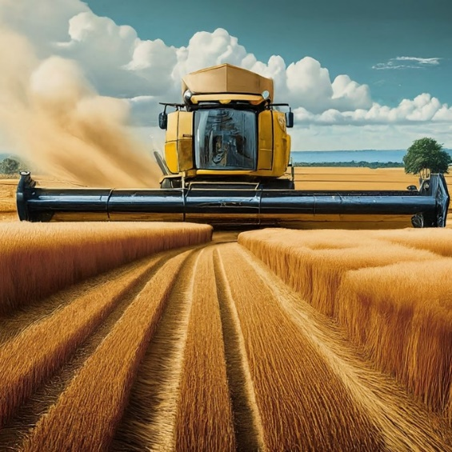
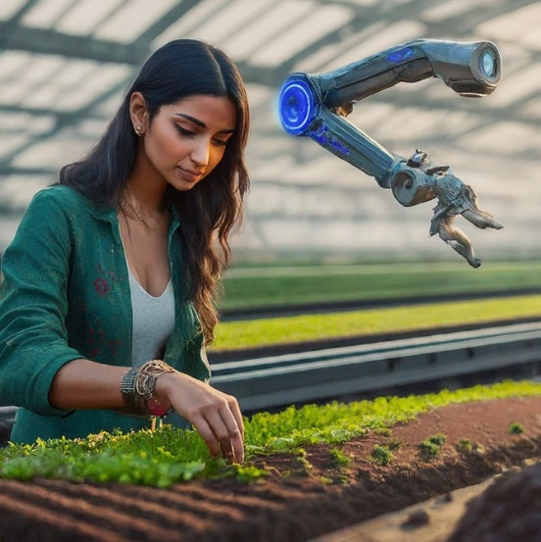
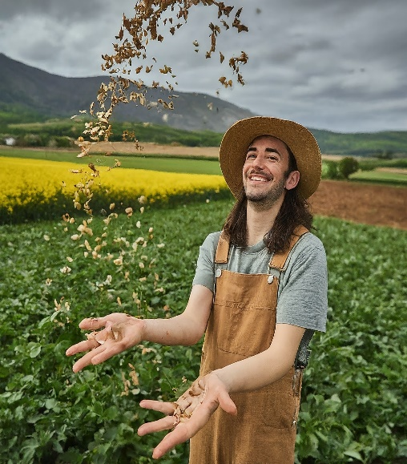
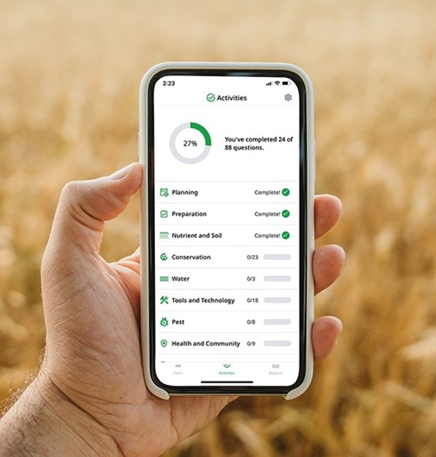


Carlos is a small-scale grower in Brazil, having land of 30 Ha
Until he stumbled upon his inheritance from his family which was 200 Ha
He was confident he could handle this land but later which turned into a nightmare
It surely gave him a hard time and was definitely a tough season for him
Until he heard a knock at the door….

Slide 3


Syngenta's TSR
Cultivating Success with Carlos
Land Preparation
Carlos is a small-scale grower in Brazil, having land of 30 Ha
Until he stumbled upon his inheritance from his family which was 200 Ha
He was confident he could handle this land but later which turned into a nightmare
3
Classification: INTERNAL USE ONLY

Slide 4




PHASES

Slide 5
Following this, there are a few phases for
Cropwise Strategies for Carlos
PHASES

Slide 6
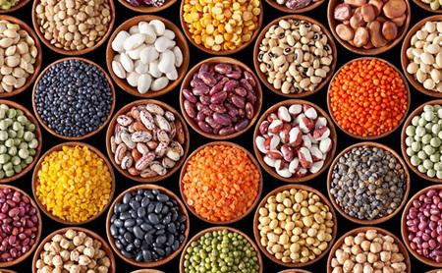

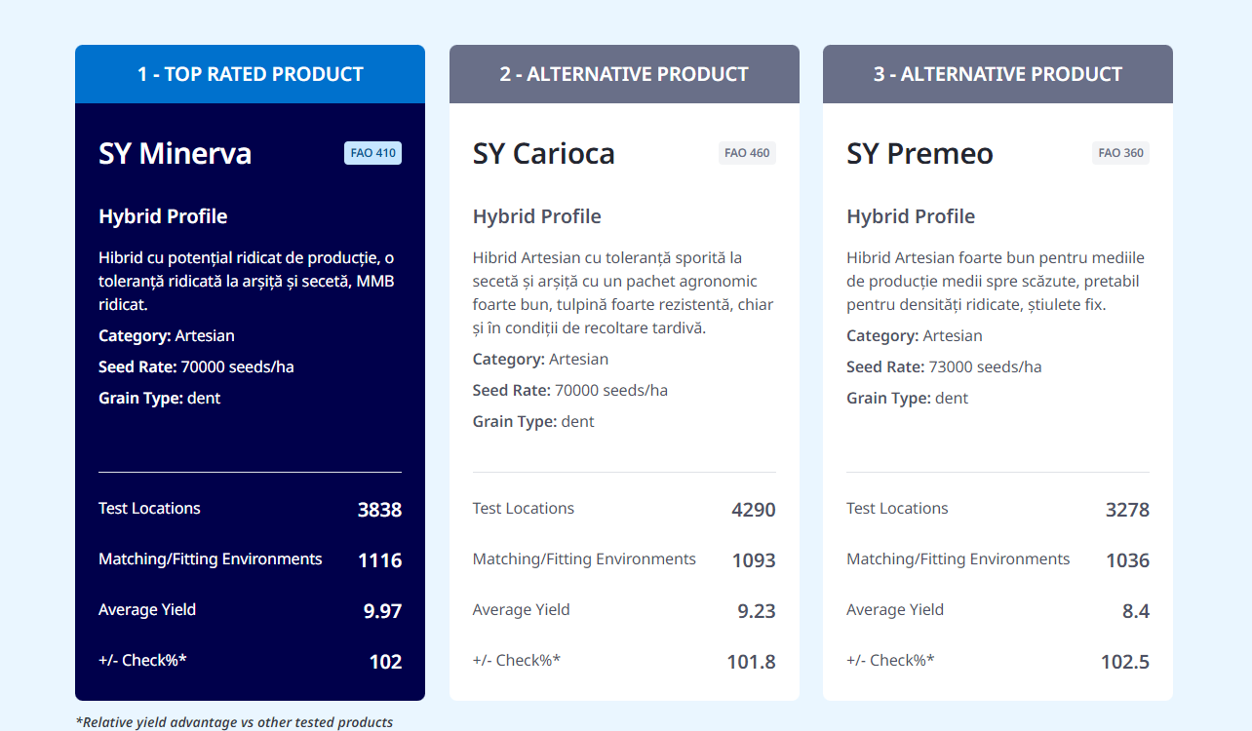
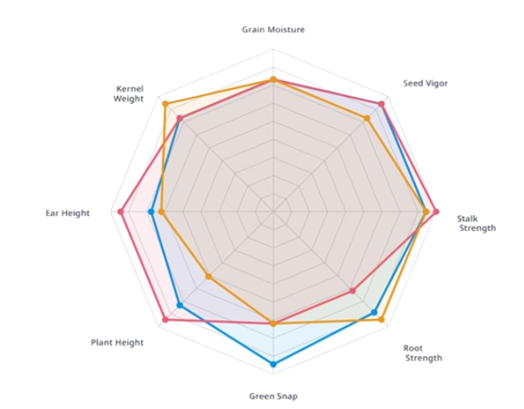
Seed Selector Seeds of Success for Carlos
SY Calo
SY Fregat
SY Helenor
PHASES

Slide 7
Seed Selector Seeds of Success for Carlos
SY Calo
SY Fregat
SY Helenor
PHASES

Slide 8

Planting
Minimizing Waste and Maximizing Yield in Every Planting
Optimize Productivity: Manage field zones with precision for enhanced efficiency.
Variable Rate Technology: Implement data-driven strategies for tailored planting prescriptions.
Satellite Imagery Integration: Leverage satellite data for real-time insights into soil and crop conditions.
Resource Efficiency: Maximize resource use for improved sustainability and yield potential.
PHASES

Slide 9
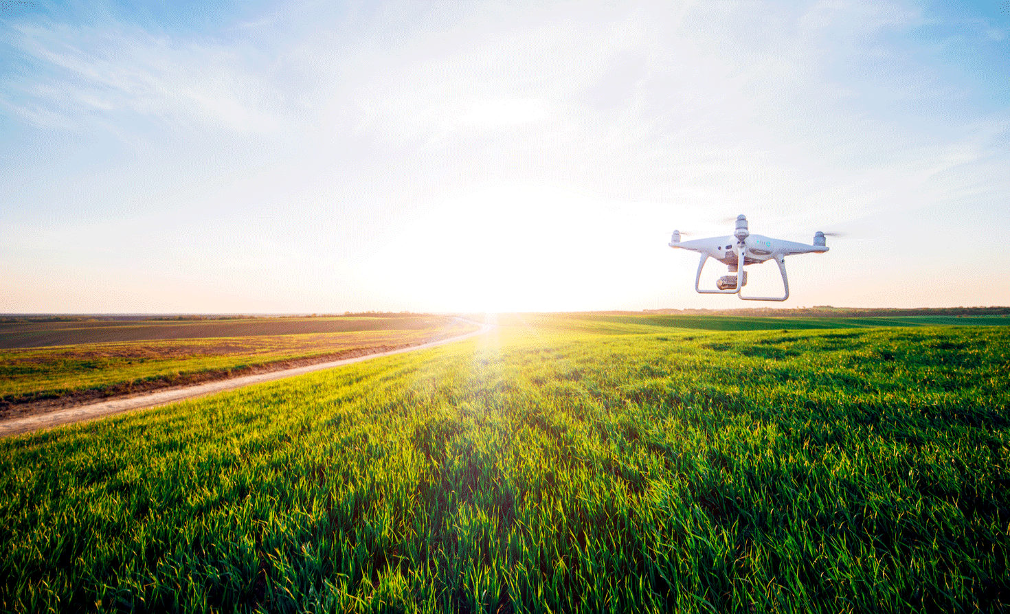
Monitoring Crop Health
Imagery and Insights Engine's Intelligent Analytics
Aerial Views: Capture field insights via remote satellite imagery.
Plant Health Analysis: Utilize imagery for assessing and monitoring plant health.
Scouting Efficiency: Identify issues promptly, allowing for timely intervention.
Priority Areas: Pinpoint critical zones for targeted and effective agricultural interventions.
Model-Driven Insights: Harness the power of data models within Insights Engine's architecture.
PHASES

Slide 10
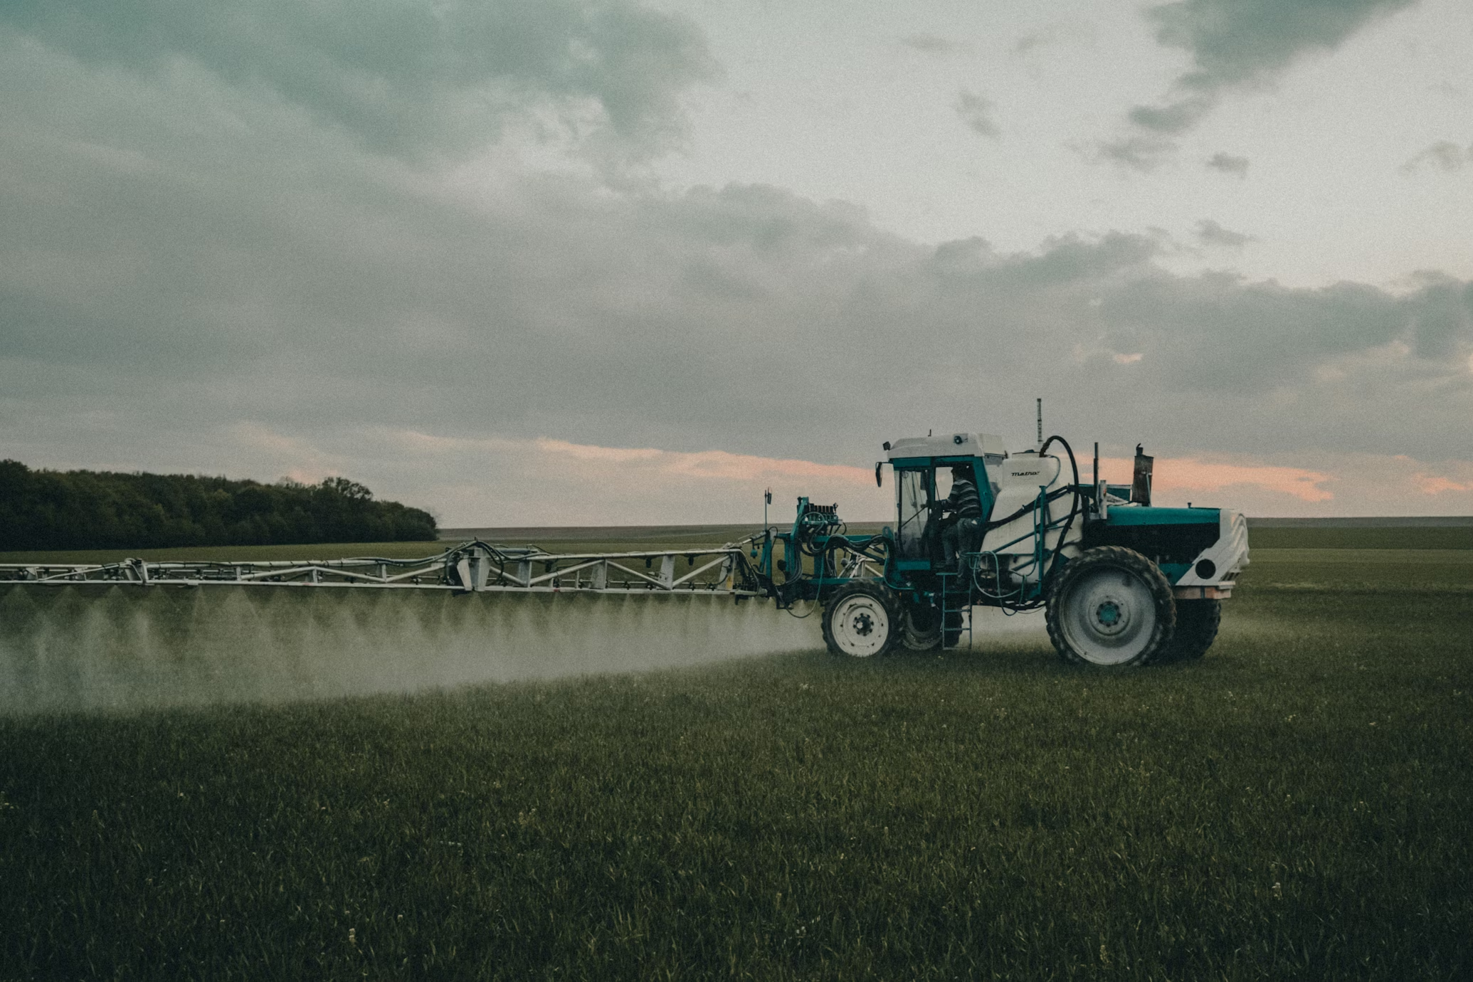
Syngenta's Cropwise SprayAssist
Optimal Crop Growth through
Precision Fertilization and Pest Control
Infestation Detection: Identify infected crop regions accurately.
Precision Pesticide Recommendations: Suggest targeted pesticides for effective pest control.
Fertilizer Application: Enhance crop yield with precise and efficient fertilizer spraying.
Integrated Pest Management: Streamline pest control and fertilization for optimal results.
Smart Intervention: Address crop issues promptly for improved overall health and productivity.
PHASES

Slide 11
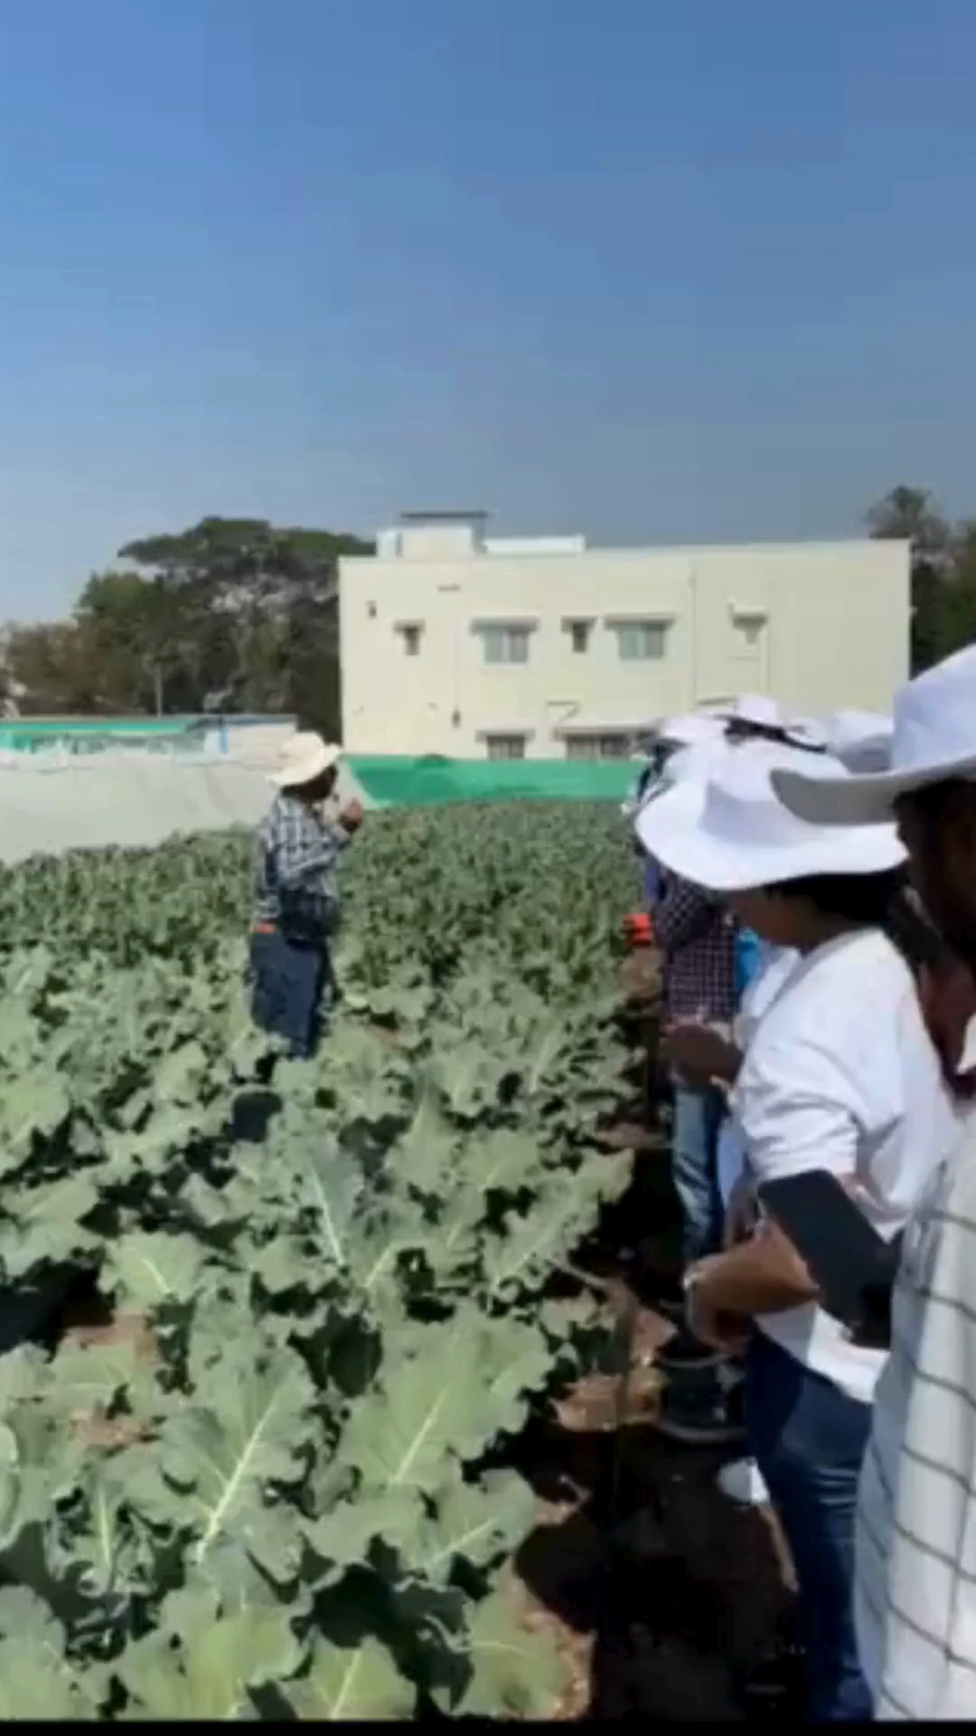
A short Reel
PHASES

Slide 12
Commodity Pro
Invest in advanced technology to optimize yield and protect purchases from price fluctuations during the growing season.
Safeguard Margins: Protect agricultural margins from volatile price movements.
Maximize Yield: Invest in premium technology to optimize and maximize crop yield.
Confidence in Syngenta Products: Gain confidence in Syngenta's crop protection and seed products.
Volatility Reduction: Reduce farm profitability volatility with this comprehensive solution.
Cashback Assurance: Receive 15% to 20% cashback if commodity prices turn unfavorably.
PHASES

Slide 13


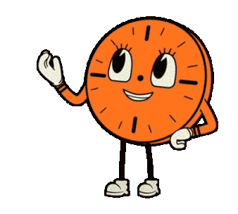
Cropwise Insights Guide
Carlos in Timing the Perfect Crop Harvest for Maximum Yield.
PHASES

Slide 14
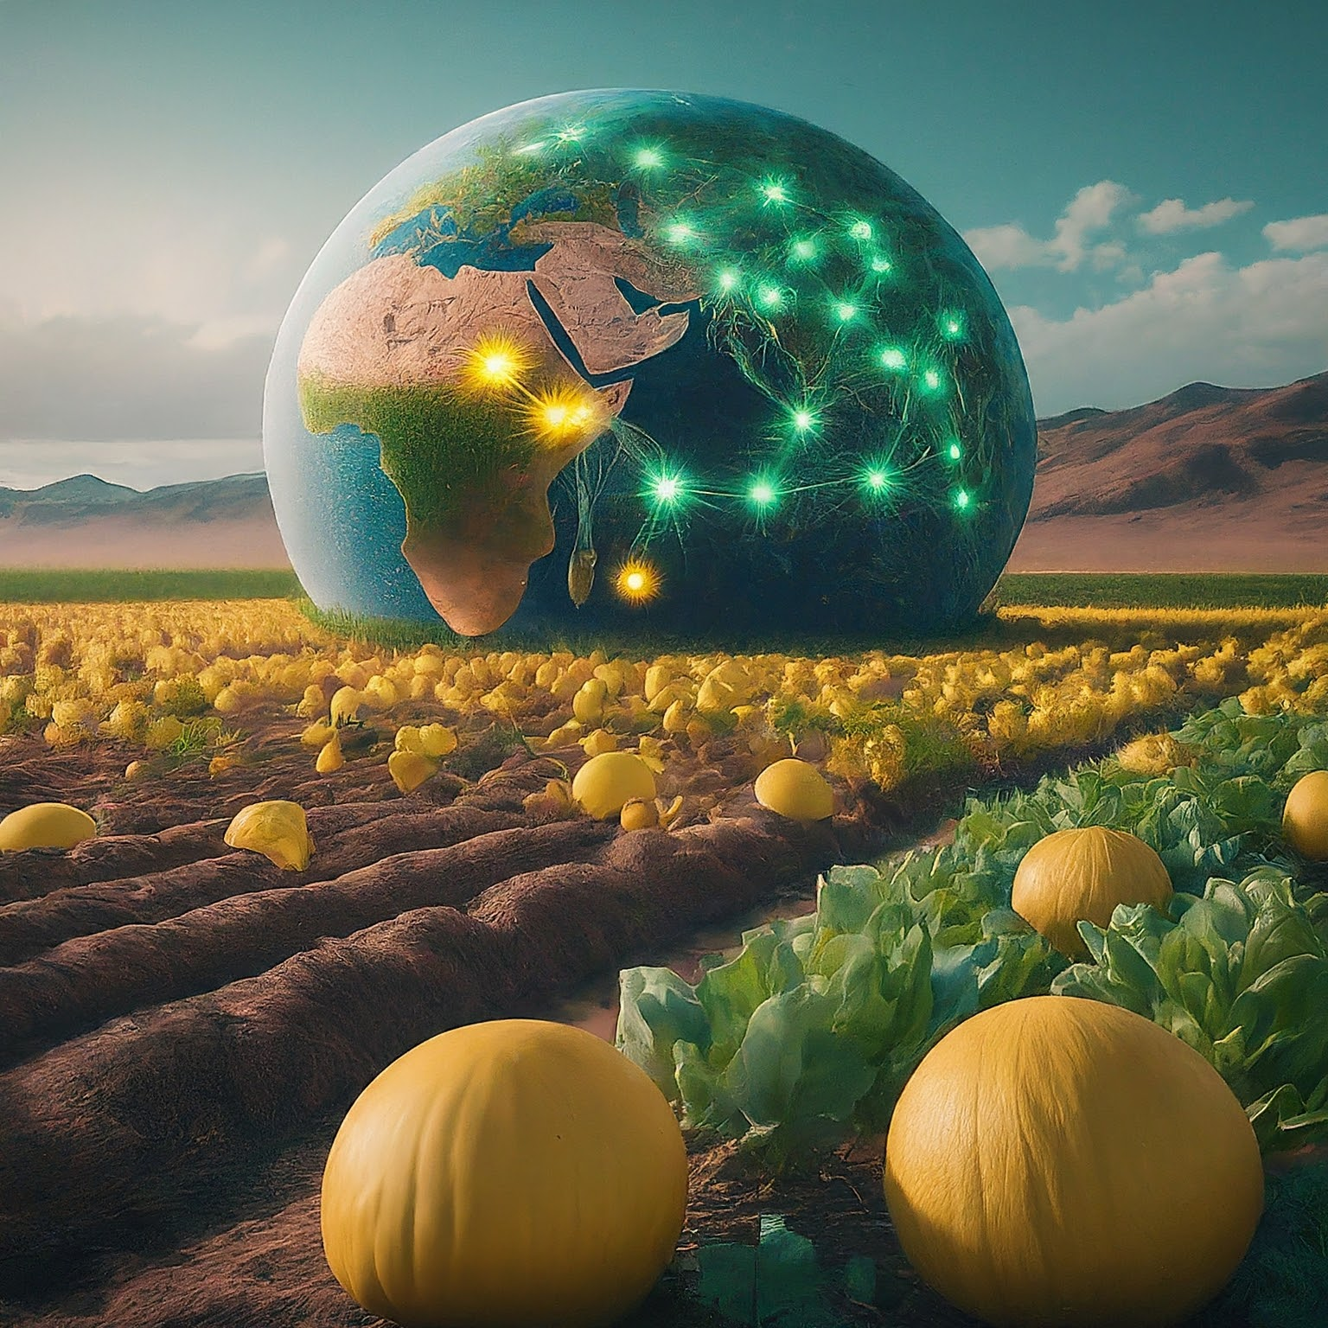

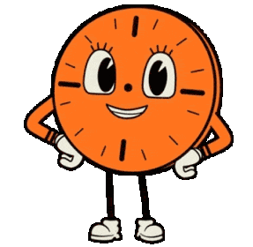
Cropwise Sustainability
Elevating Carlos's Farming with Personalized Insights, Community Benchmarking, and Carbon Score Calculations for a Greener Tomorrow
PHASES

Slide 15


Syngenta’s Solemnity
So Carlos, once a humble grower grappling with challenges is now a beacon of success.
His journey with Syngenta has not only transformed his life but also paving the way for a more sustainable and prosperous future for agriculture in Brazil

Slide 16


A short reel for real this time….

Slide 17
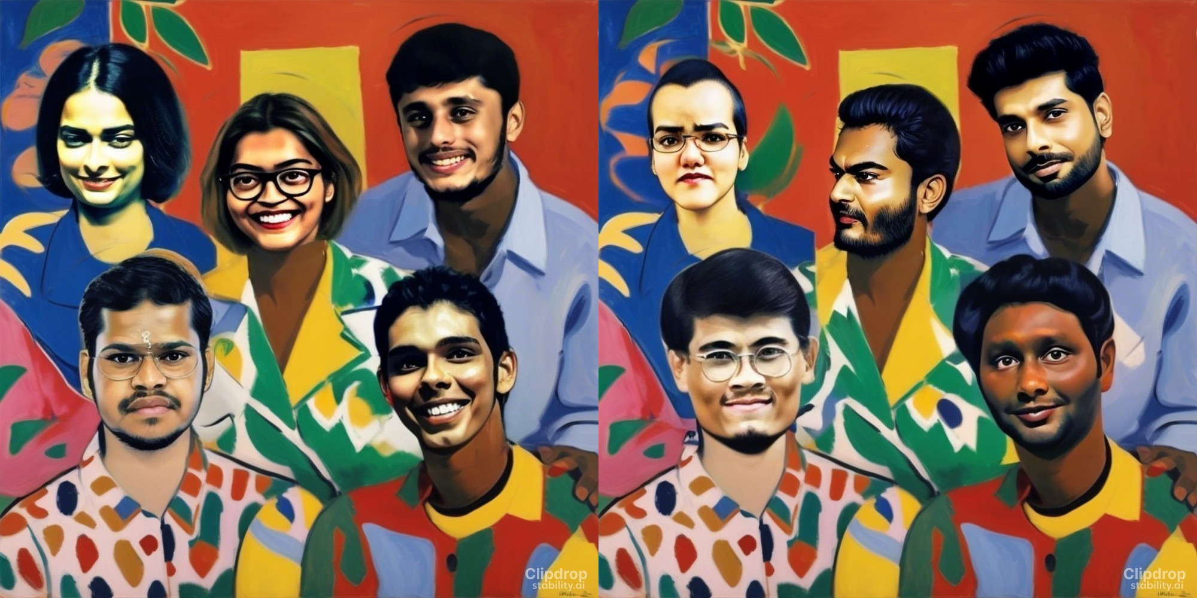
Thank You

